Slide 1
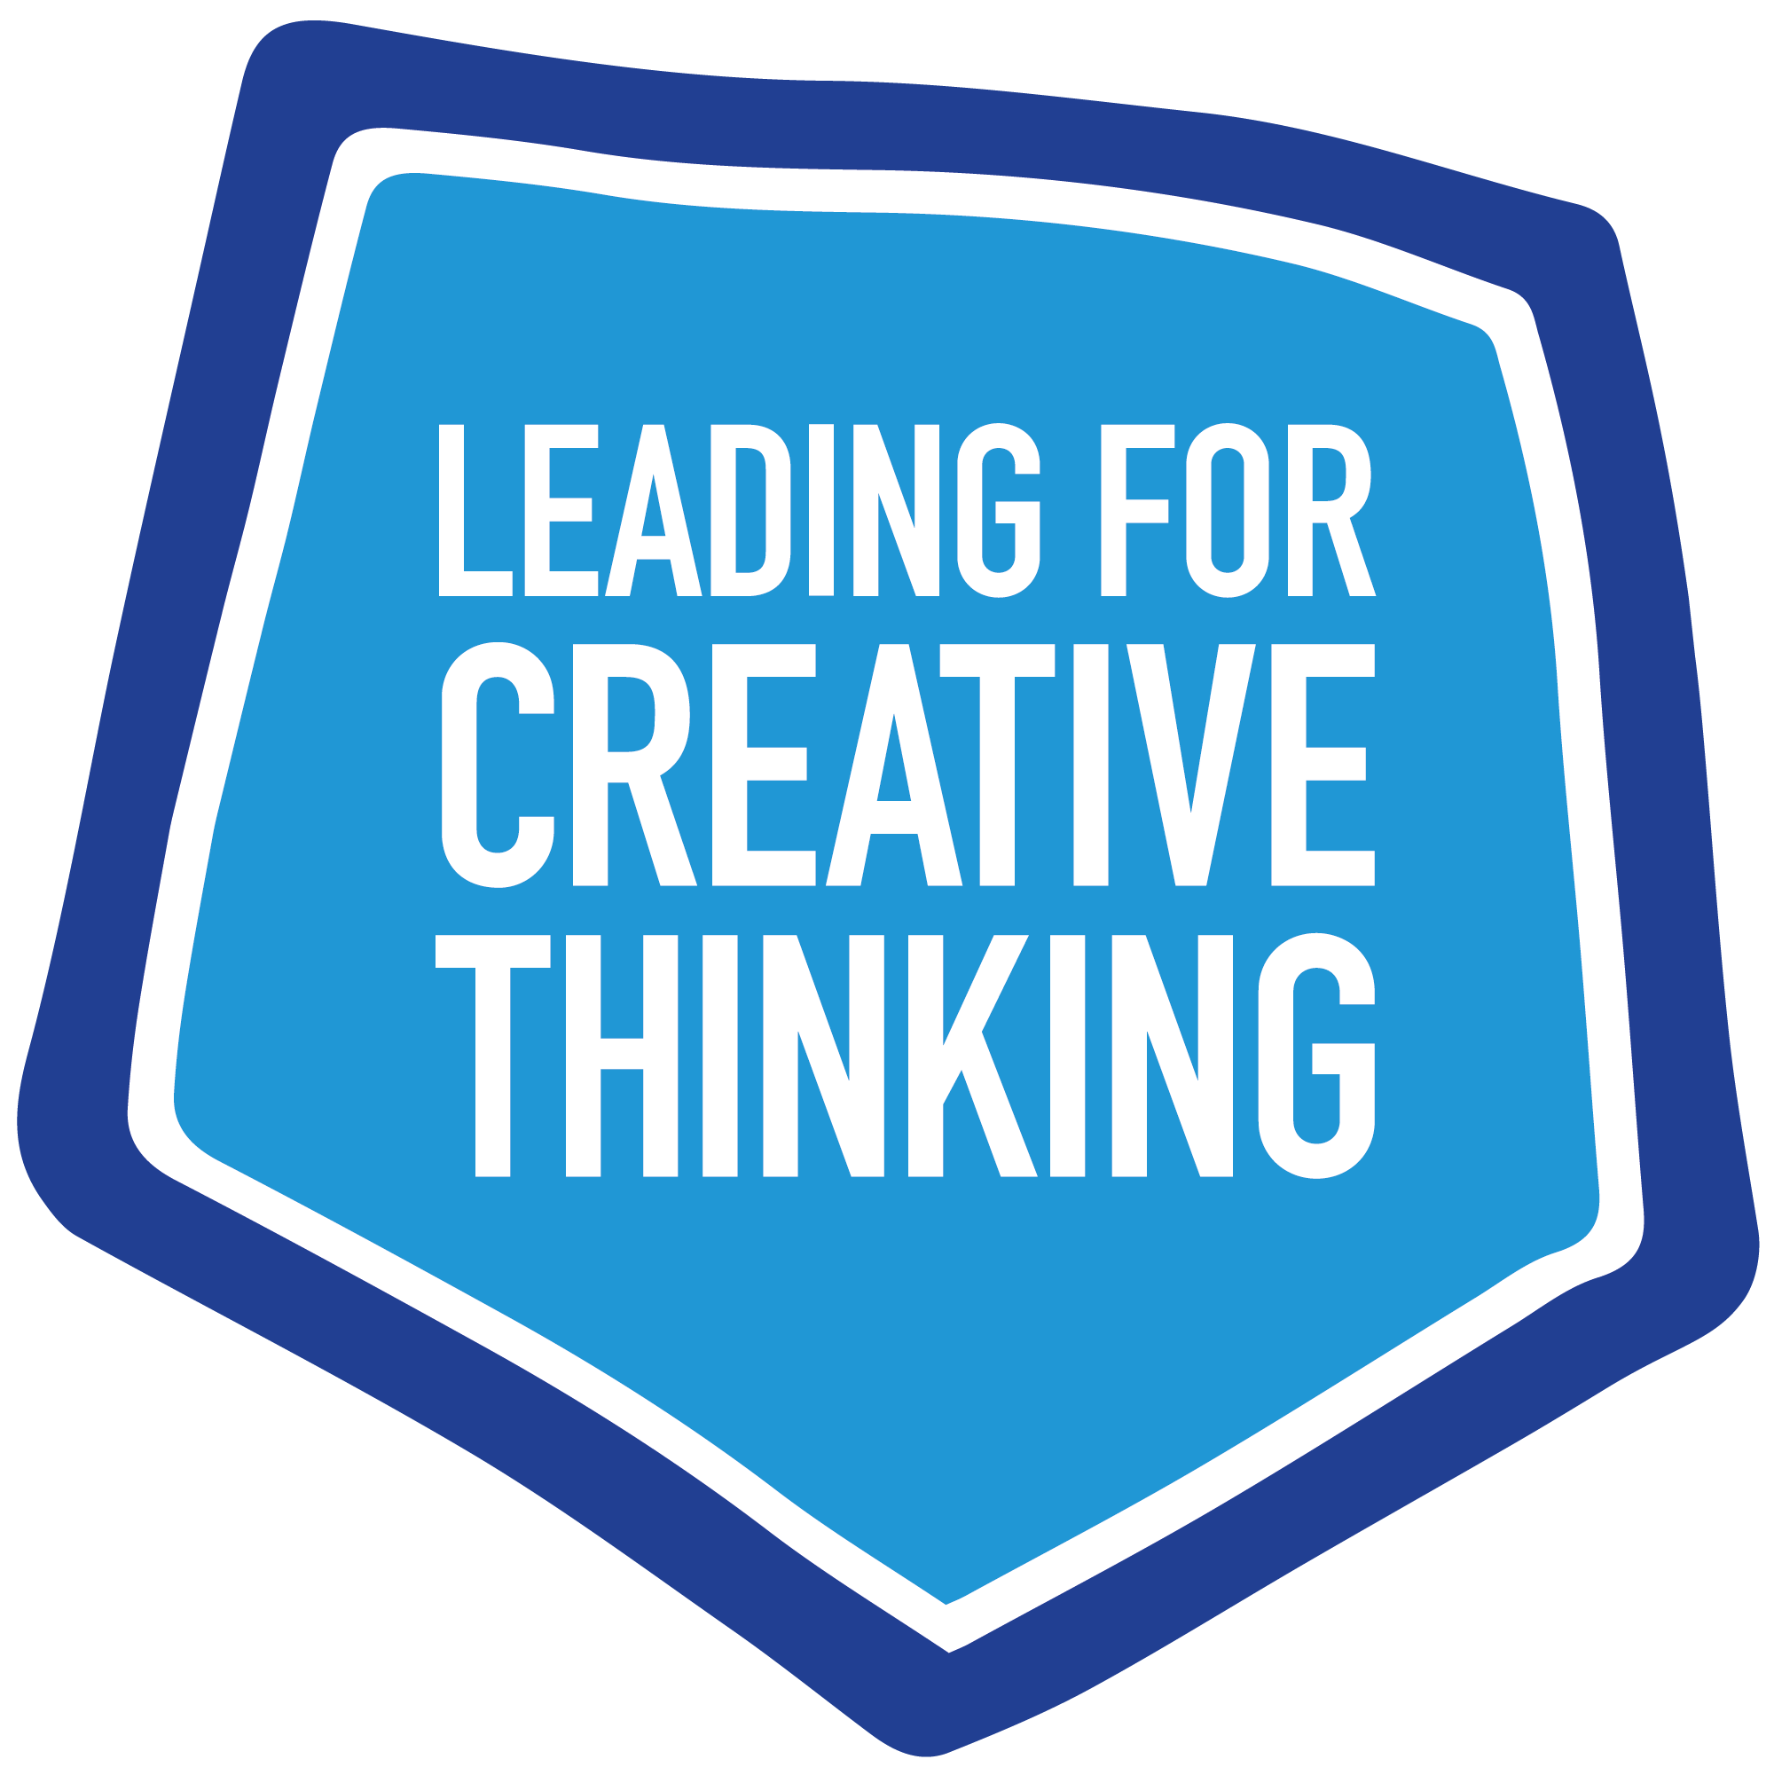
Extracts from PISA 2022 Results - Creative Minds Creative Schools
Organisation for Economic Co-operation and Development (OECD) Programme for International Student Assessment (PISA) 2022 Results - Creative Minds, Creative Schools

Slide 2
What is PISA?
What should citizens know and be able to do? In response to that question and to the need for internationally comparable evidence on student performance the OECD launched PISA in 1997 and the first assessment was conducted in 2000.
PISA is a triennial survey of 15-year-old students around the world that assesses the extent to which they have acquired key knowledge and skills essential for full participation in social and economic life. PISA assessments do not just ascertain whether students near the end of their compulsory education can reproduce what they have learned; they also examine how well students can extrapolate from what they have learned and apply their knowledge in unfamiliar settings, both in and outside of school.
While the eighth assessment was originally planned for 2021, the PISA Governing Board postponed the assessment to 2022 because of the many difficulties education systems faced due to the COVID-19 pandemic.

Slide 3
PISA 2022 Results:
Creative Minds, Creative Schools
In 2022 PISA for the very first time measured the creative thinking skills of 15-year-old students. This focussed on assessing their ability to engage productively in the generation, evaluation and improvement of ideas.
In the foreword Andreas Schleicher – Director for Education and Skills and Special Advisor on Education Policy to the OECD Secretary-General reflected “As we navigate the complex environmental, social and economic changes of the 21st century, it is crucial for students to be innovative, enterprising and to use critical and creative thinking purposefully.
PISA 2022 assessed 15-year-old students’ capacity to think creatively, defined as the competence to engage in the generation, evaluation and improvement of original and diverse ideas. The PISA 2022 creative thinking data provide insights into how well education systems are preparing students to think outside the box in different task contexts.

Slide 4
PISA 2022 Results:
Creative Minds, Creative Schools cont…
Many jobs, especially those in highly skilled fields, place a premium on creative thinking. According to the World Economic Forum’s Future of Jobs 2023 report, creative thinking is ranked as the second most important skill for workers, just behind analytical thinking. Similar findings by companies like LinkedIn and Deloitte underscore the essential role of creative thinking in the modern workforce.
Yet creative thinking isn’t only about remaining competitive in the job market. It also acts as a powerful stimulus to learning itself, deepening students’ absorption in their learning, activating higher-order cognitive skills and stimulating emotional development and resilience and well-being.
It is important to reiterate that creative thinking skills can be taught. Teachers can unlock student creativity by encouraging students to explore, generate and reflect upon ideas. It's no coincidence that high-performing systems integrate formal guidelines on developing and assessing student creativity directly. Yet, worryingly, only about half of students believe that their creativity is something that they can change.
Encouraging students to better engage with more open and student centred-learning tasks can help to build self-confidence and inspire curious and creative learners. By providing students with opportunities and support to explore their creative abilities, educators can help them realise that creativity is not an innate trait but a skill that can be honed and improved.

Slide 5
How does PISA define creative thinking?
In PISA “creative thinking is defined as students’ ability to engage productively in the generation, evaluation and improvement of ideas that can result in original and effective solutions, advances in knowledge and impactful expressions of imagination”.

Slide 6
Comparing your school findings
You might compare your school findings to the following extracts from the PISA 2022 Results - Creative Minds Creative Schools.

Slide 7
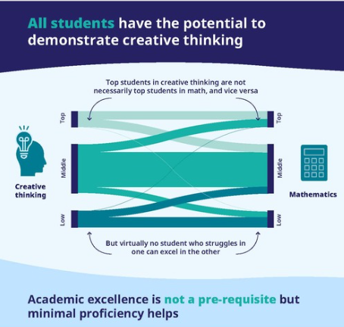
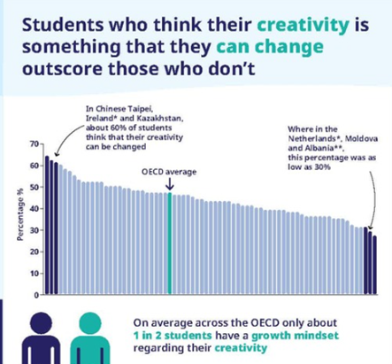
Students potential and beliefs
On average across OECD countries, around 7 out of 10 students believe that creativity is not exclusive to the arts, and 8 out of 10 believe that it is possible to be creative in nearly any subject; in Chinese Taipei and Portugal, this number is closer to 9 out of 10 students. Students who hold these beliefs about creativity tended to score around 3 points higher than their peers on the creative thinking scale on average.

Slide 8
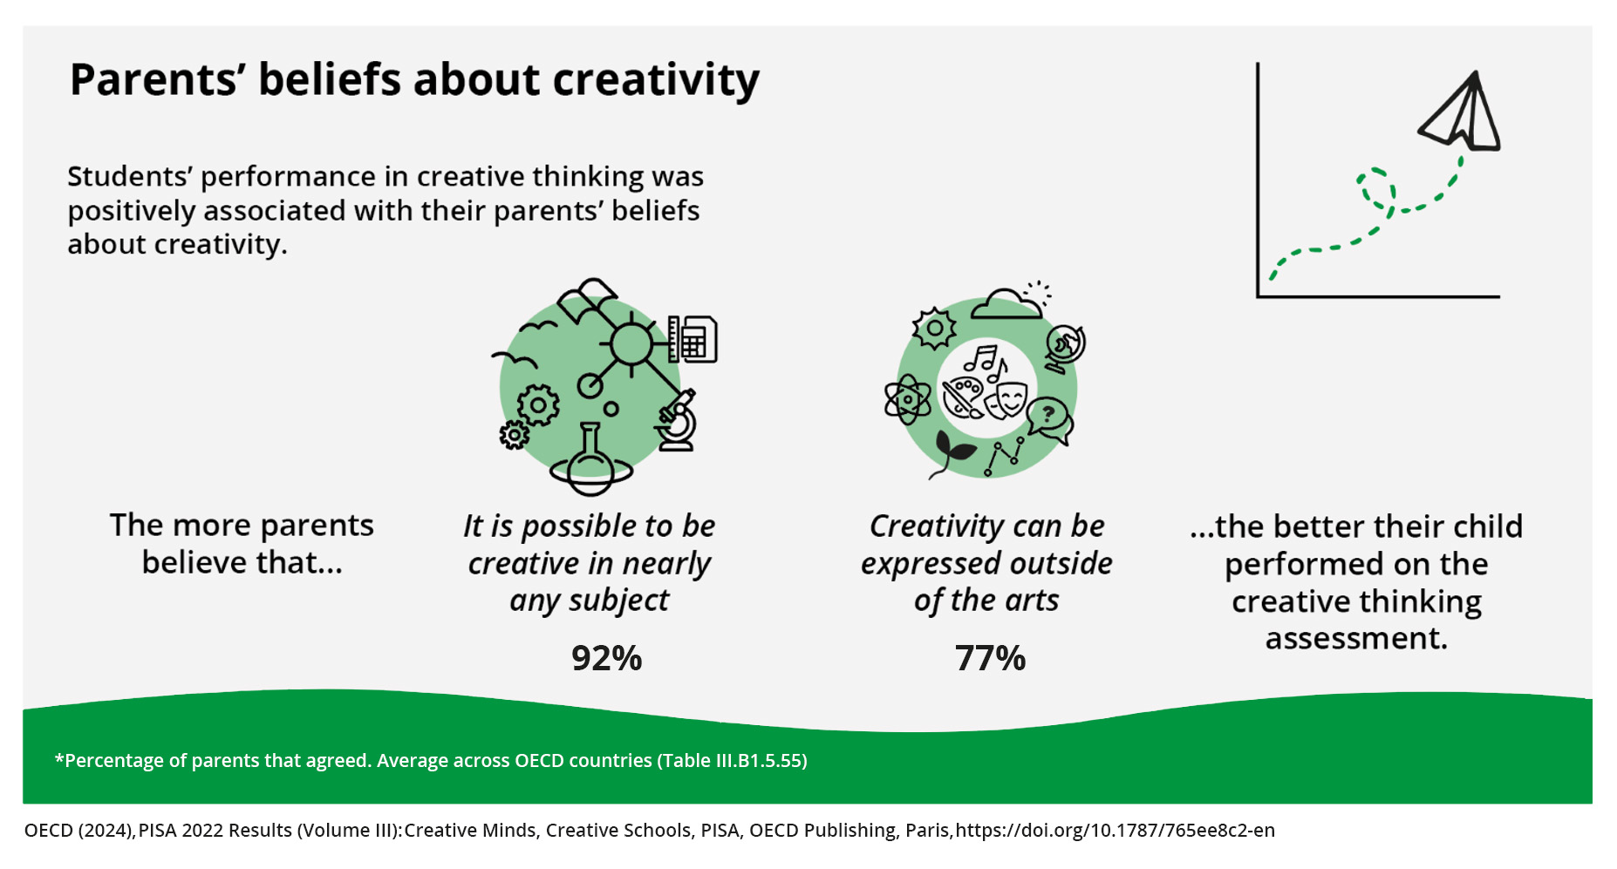
Parents’ beliefs about creativity
Parents’ beliefs about creativity are related to their child’s creative thinking performance (Figure III.5.8 and Table III.B1.5.57). This positive relationship held after accounting for gender and socio-economic status of the family and school. Women and men shared similarly favourable beliefs about the nature of creativity; but parents from advantaged socio-economic backgrounds reported much more of these beliefs than their peers (Table III.B1.5.56).”

Slide 9
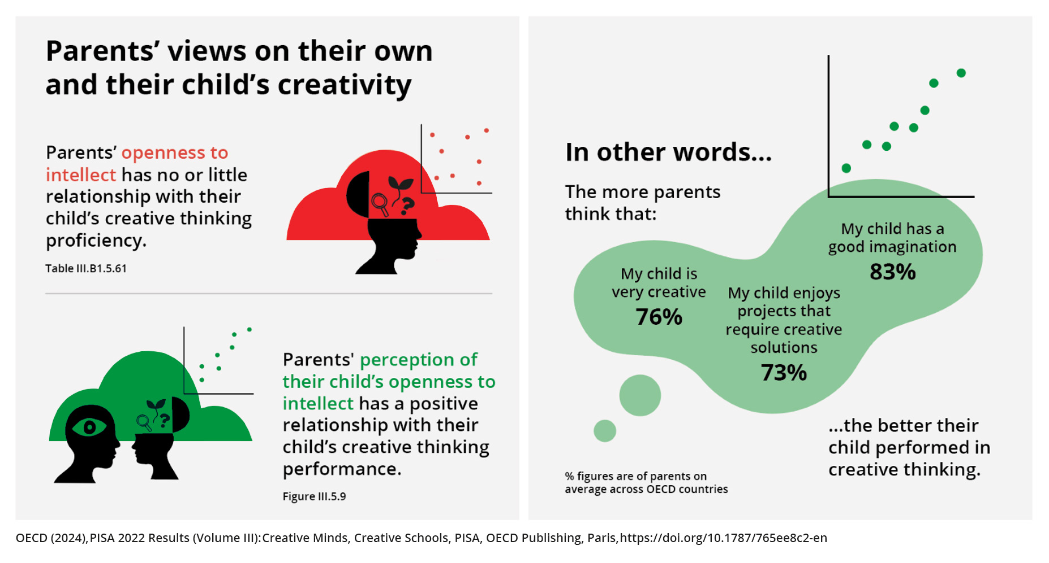
Parents’ views on their own and their child’s creativity
Again, accounting for student’s and school’s characteristics (Table III.B1.5.62 and Table III.B1.5.65). Parents who think their child enjoys learning new things, and those who think their child is very creative .

Slide 10
Making the case for creative thinking
The PISA 2022 results also highlighted “Strong performance in creative thinking and academic subjects is both possible and complementary”.
Academic excellence is not a pre-requisite for excellence in creative thinking…
The PISA results show that it is possible to be proficient in both creative thinking and in the core subject areas of mathematics, reading and science. Student performance in creative thinking correlates positively to performance in the PISA core domain assessments (correlation of between 0.66 and 0.67).
This data implies that performance in creative thinking and academic performance are complementary to some extent – particularly at the upper and lower ends of the proficiency scales – but that academic excellence is not a pre-requisite for excellence in creative thinking. Indeed, PISA data shows that it is possible for many students to be strong creative thinkers, not just those who perform at the highest levels in mathematics, reading and science.
…but students need a baseline level of skills in core subject areas to excel in creative thinking.

Slide 11
References
OECD (2024), PISA 2022 Results (Volume III): Creative Minds, Creative Schools, PISA, OECD Publishing, Paris, https://doi.org/10.1787/765ee8c2-en

